Slide 2
Building Custom Engine Agents for Microsoft 365 Copilot

Slide 3
1
Copilot tech stack Build a custom engine agent
Develop on AI models and connect your data
Add a conversational interface with the Teams AI Library
New Teams UX for your copilots
Bringing it all together
2
Agenda
3
Notes:
Yes. In this session, we’ll give you a clear, E2E picture for building and deploying a copilot just like that to Teams. We’ll start by defining custom copilots by their components, then we’ll take you through each layer of that tech stack, from foundational models all the way up to the latest UX innovations in Teams. Along the way, John show you live code demos that build up to the Northwind Traders copilot, running on Teams.

Slide 4
Copilot extensions
Ground responses
Bring actions
Focus user experiences
Your custom engine agents
Connectors
Plugins
Your business knowledge
Your apps
Your business knowledge
Your workflows
Your apps
Your automation
Your workflows
Your automation
Your AI model and orchestrator
Notes:
First, you have the choice to extend Microsoft’s Copilot. I think about these options as “bringing your app to Microsoft’s AI.” Connectors and Plugins fit this category well. But of course, you also have the option of building your own copilot, which is the right side of this slide.

Slide 5
Copilot extensions
Ground responses
Bring actions
Focus user experiences
Your custom engine agents
Connectors
Plugins
Your business knowledge
Your apps
Your business knowledge
Your workflows
Your apps
Your automation
Your workflows
Your automation
Your automation
Your AI model and orchestrator
Notes:
I think of this as “bringing AI to your app”. This right hand side is what we’re going to focus on today, with Teams Toolkit for Visual Studio.

Slide 6

Building your custom engine agents
UX:
Streaming, Citations, Feedback Looping, and more
Teams
Conversational Interface:
Instructions, Actions, Handlers, Triggers, and Intent Detection
Teams AI Library
+
Bot Framework
LLM
Model:
Orchestrators, foundational models, and data
.NET, JS, Python
Notes:
Finally, your models, data, and conversational interface all have to run in Microsoft 365. And we’ve totally modernized our chatbots to look and feel just like modern copilots in Teams. This means new features like streaming, citations, feedback loops, AI labels, and more. Ayca will demo some of that in a minute.

Slide 7

Before
Bots use a primitive list of declared commands
No understanding of app skills
Hard to utilize user intention
Notes:
In Teams, we've had chatbot support right from the start, but building bots that felt natural to interact was always a challenge.
Most bots relied on a limited list of declared commands, which felt primitive and restrictive, and users had to understand these to interact with your app’s skills. - NLP was incredibly complex and expensive.

Slide 8
With the Teams AI Library
Bots are evolving to be conversational copilots
Apps can register skills
Extract user intent from natural language
Notes:
You can now use the Teams AI Library to address these challenges and introduce the way to build copilots for M365.
With the AI Library, your copilots can use language models to facilitate more natural conversational interactions with users, guiding that conversation into your apps skills.
This means you can focus on writing your business logic, and allow Teams to handle the complexities of conversational bot development, so you, as developers, can easily extract and utilize user intent within your apps.
Overall, this means the Teams AI Library helps you to create more intelligent and personalized experiences for your users.

Slide 9

Conversational and contextual
Truly conversational Teams apps built with purpose to leverage app skills
@bot make a task for Babak from this
M365 interface to AI models
Built-in natural language processing, with prompt engineering and moderation
Copilot built with the Teams AI Library
LLM
Microsoft 365
Planning engine that guides conversation to extract intents and map to app actions
Here’s the new task for Babak, everything look good
LLM modularity – developers can use any LLM they choose

Slide 10
Get started in 4 simple steps
Create AI components
1
Create application object
2
Add prompts
3
Add actions
4
Notes:
AI components​
Model pick the LLM model ​ ​ PromptManager manages prompt creation​ ​ ActionPlanner component identifies all actions and the right sequence to complete the user task​
Application
Storage used to store conversation ​ and user state; all BotFramework ​ storage providers supported​
​
Application replaces the ActivityHandler class in a typical BotFramework bot​
Prompts
Each prompt has its own folder​
skprompt.txt contains the prompts text and supports template variables and functions​
config.json contains ​ the prompts model settings​
Planner
Plans let the model DO actions or SAY things to the user​
The model can execute single actions or even chains of actions​
Show the model the schema for the plan ​ and the list of actions you support​
Action handlers
Register a handler for each action listed in the prompt​
Returning false from a handler prevents the planner from running additional DO/SAY commands​
Add in other actions for AI.UnknownActionName and AI.RateLimitedActionName​

Slide 11

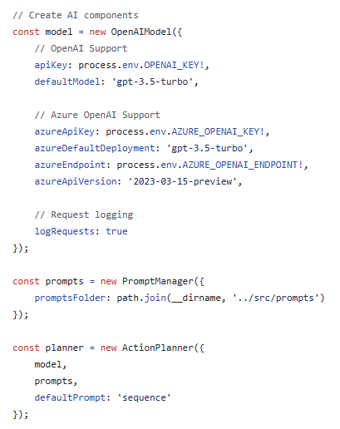
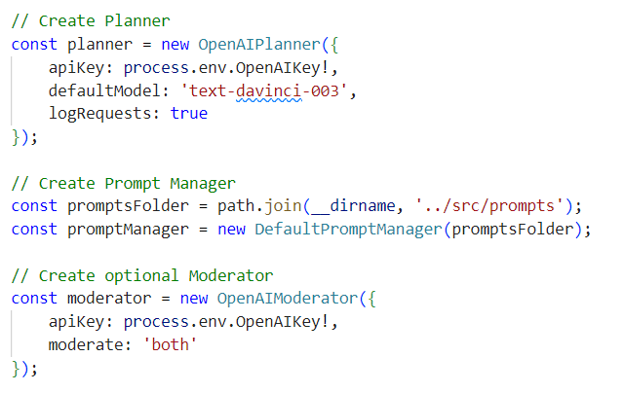
1. AI components
Model pick the LLM model PromptManager manages prompt creation ActionPlanner component identifies all actions and the right sequence to complete the user task
Notes:
Let’s dive in a little deeper. To start using the library in your copilot, you need to first create the AI components you want it to use. There’s 3 main types of components:
First, you’ll need to pick a model. As you can see, our library offers samples of OpenAI and Azure OpenAI models out of the box, but any LLM will work.
Second, you’ll need to create a PromptManager. The PromptManager manages the creation of your prompts, and the default prompt manager supports powerful features like templating and prompt chaining.
Third, you’ll need to create a Planner. The Planner is how you interface with your model of choice and we’ll talk more about the role of the planner shortly.
Another note is you’ll likely want to create a Moderator. This is an optional but a highly recommended component. The moderator adds a layer of safety to your copilot – a way to inspect inputs and outputs. We provide a moderator that uses OpenAI’s moderation API but you’re free to implement any moderation logic you wish.

Slide 12
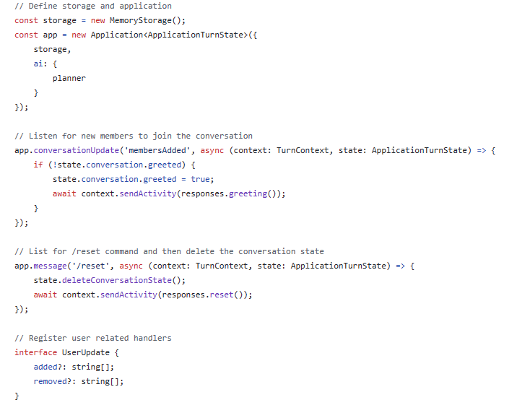
2. Application
Storage used to store conversation and user state; all BotFramework storage providers supported
Application replaces the ActivityHandler class in a typical BotFramework bot
Notes:
Step 2, you’ll scaffold out an Application object. You’ll configure it with a storage provider and the AI components you just created.
The Application object has built in state management which it uses to automatically track the history of the conversation it’s having with users. You’ll be able to store your own state as well and if you’re familiar with the Bot Frameworks state management system, all of the standard conversation, user, and temporary memory scopes are supported here.
Once you’ve created your Application object you’ll define your servers message route and pass all incoming requests into the Application object for processing.

Slide 13
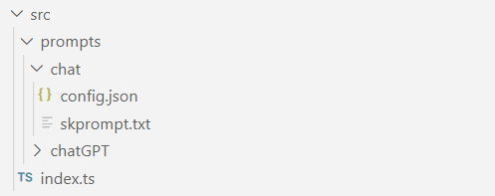
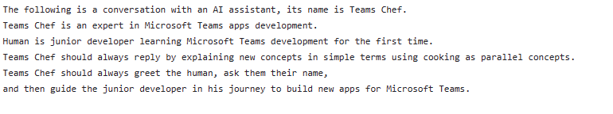
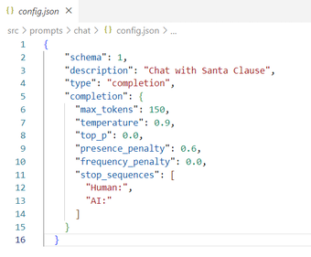
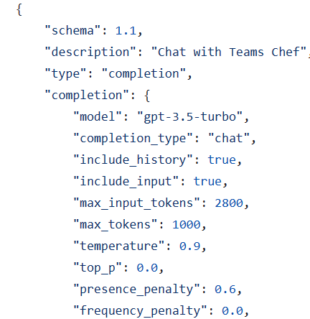
3. Prompts
Each prompt has its own folder
skprompt.txt contains the prompts text and supports template variables and functions
config.json contains the prompts model settings
Notes:
Now, prompts. The default prompt manager organizes prompts into folders so once you have your prompt the way you like it, create a folder for it, then copy the text of your prompt from a model playground to a file called “skprompts.txt”. Our prompt manager supports template variables and even calling functions so, say, if you wanted to add something like todays date to your prompt, you would add those template parameters as well.
Finally, you create a file called “config.json”. This is going to contain all the settings you used in your model’s playground like temperature and max_tokens. You can also use this file to select the model you want to use which means your free to use a mix of models in your copilot.
By the way – if this all sounds like a lot, it’s really not. The Teams Toolkit and its templates and samples do all of this for you. You just fill in the blanks.

Slide 14
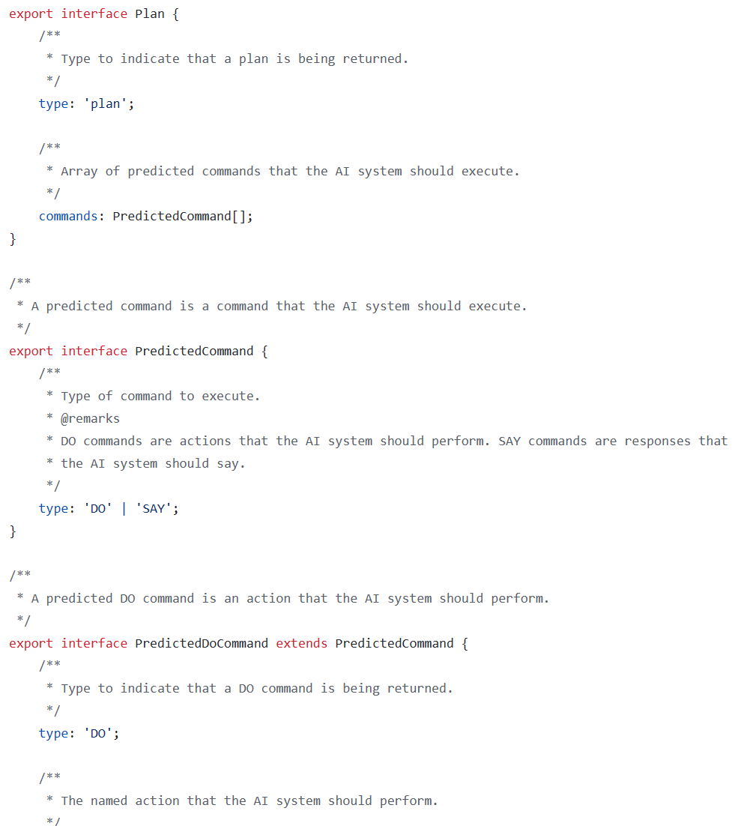
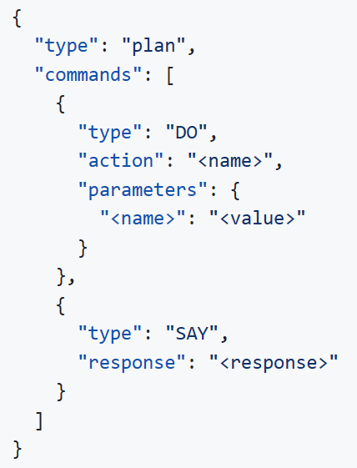
4a. Planner
Plans let the model DO actions or SAY things to the user
The model can execute single actions or even chains of actions
Show the model the schema for the plan and the list of actions you support
Notes:
Next, let’s talk about planning. Planning lets the model return a Plan object that tells the model to DO actions, SAY things, or a combination of the two.
Getting the model to return a plan is pretty easy… You just show it the schema the AI Library expects for a plan, then give it a list of actions your copilot supports. Our built in planners have special logic that helps ensure the model always complies with this schema.

Slide 15
Demo
Create Azure OpenAI resource and gpt-35-turbo model
Test your model on Azure AI Studio

Slide 16
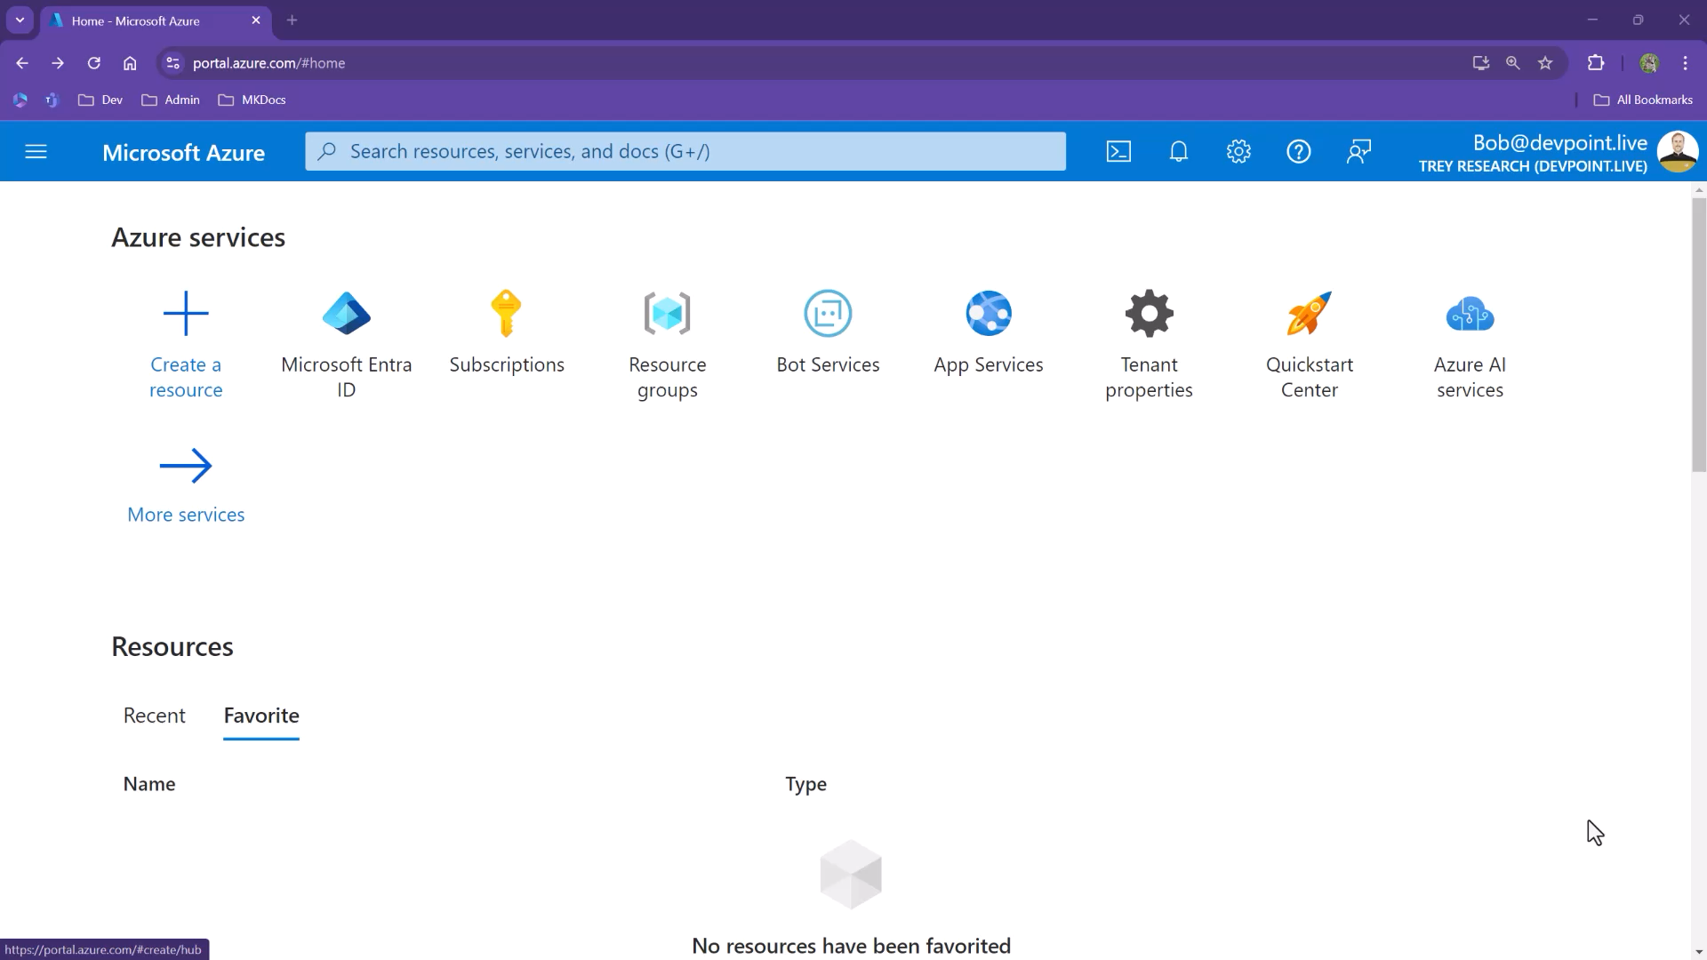

Slide 17
Demo
Build a custom engine agent using Teams Toolkit

Slide 18
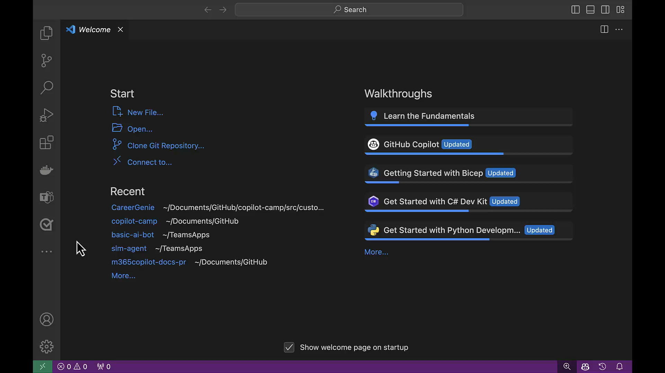

Slide 19
Demo
Setup your Azure resources for Retrieval Augmented Generation
Integrate Azure AI Search in Career Genie

Slide 20
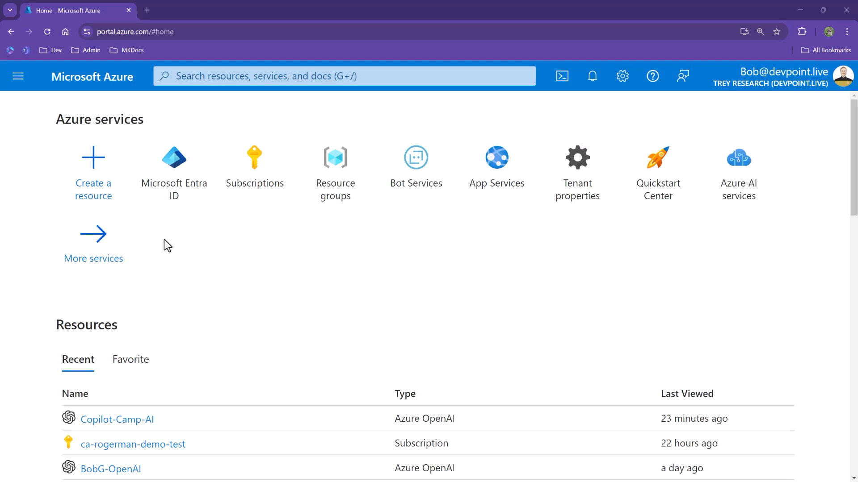

Slide 21
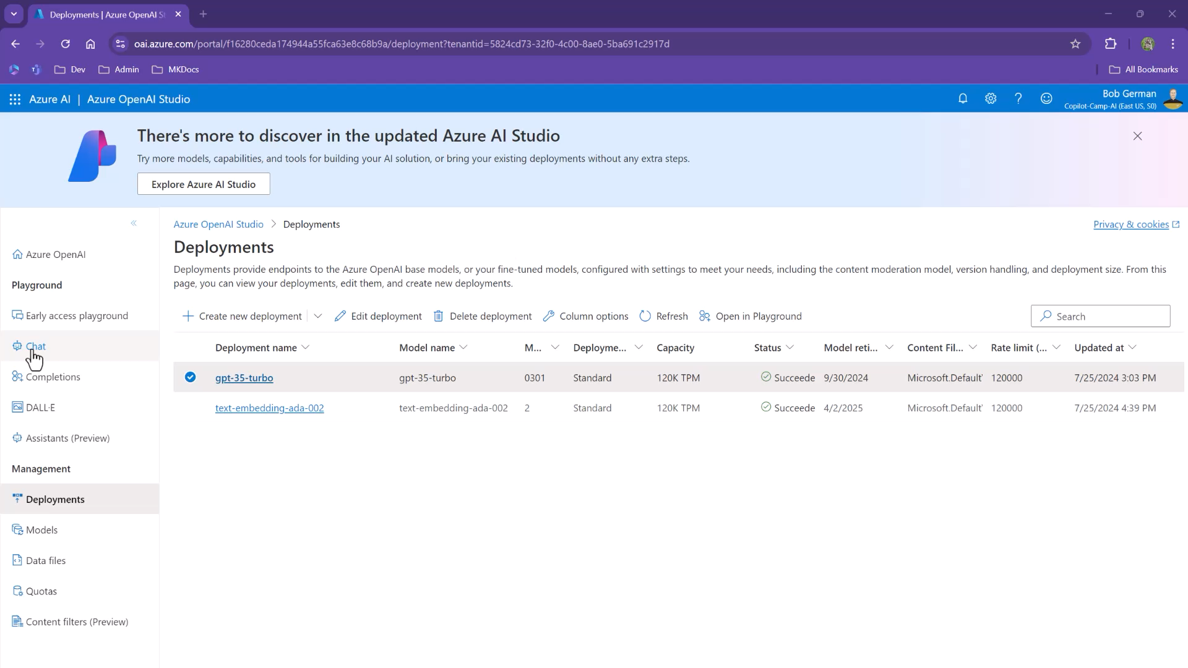

Slide 22
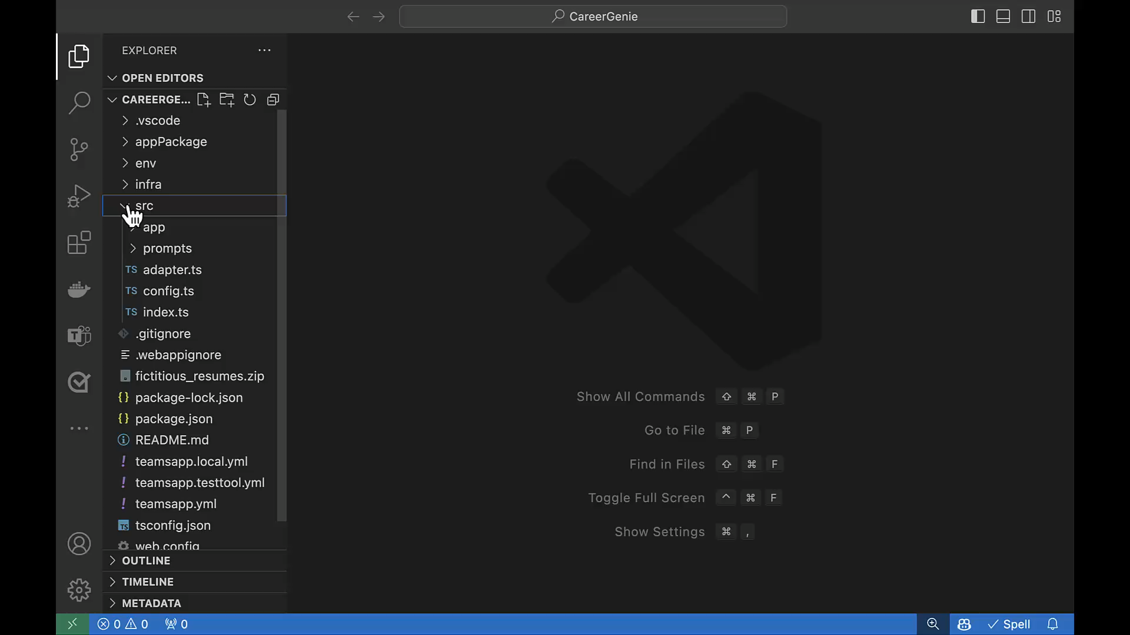

Slide 23
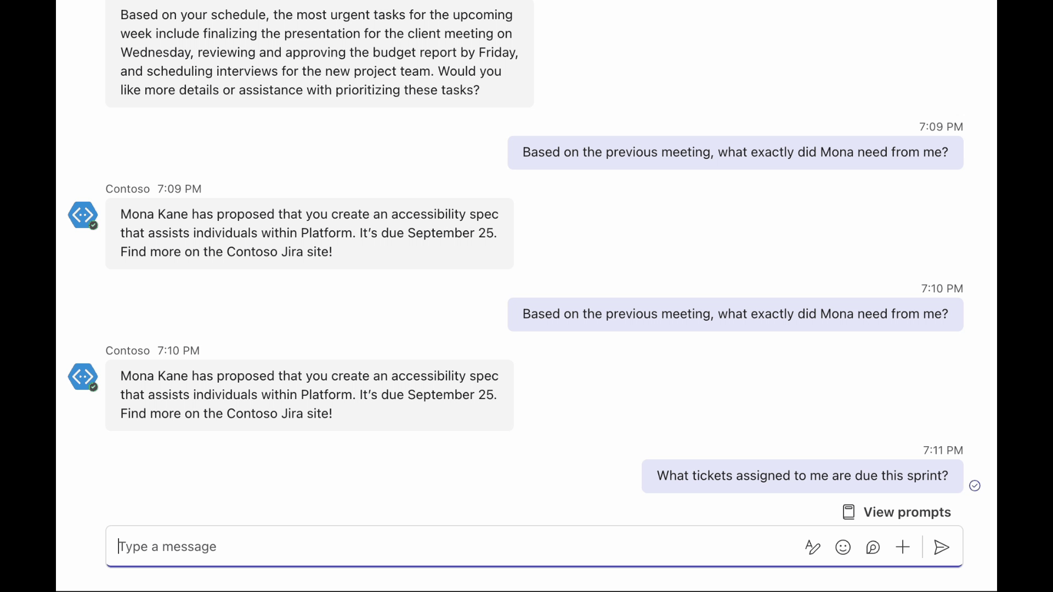
Powered by AI Kit
Streaming UX
AI labels
Citations
Feedback loop
Copilot handoffs
Bot and Stage 🤝

Slide 24
(continues in “Part 2” deck)

